Slide 1

CHRISTUS Health
Monthly Status- monthyear

Slide 2
Role Based Access
Targeted work around billing errors, clean ups, streamlining workflows
Key Achievements
Module in numbers- or added explanation
Successfully completed NPPES imports, clean up activities related to specialty, Correction imports related to Taxonomy, irregular sequence of network and Provider type mis-match
Service Now Tickets
33
Takeaways
POTF
33
74
NPPES imports
CHG Management
235
790
Revenue Cycle
Goals for nextMY
ONGOING ACTIVITES
Takeaways
Automation
Data Analytics
Integration
Optimization

Slide 3
MyChart
Module in numbers- or added explanation
Key Achievements
Here are the key achievements for August 2025, highlighting our significant progress and milestones:
Scope of work
Nova Notes
Knowledge exchange
Solution & Delivery
Work packets
Highlights for monthyear
Ownership of REQ and CIM :
Nova Notes build tasks:
Prompt resolution of SNOW tickets:
Link to MyChart interactive Dashboard:
*Reviewed 150 Nova notes on a call with onshore team

Slide 4
MyChart
Gold Stars & Diamonds
Goals for Gold Stars & Diamonds
Quarter-wise Distribution for Gold Stars and Diamonds or added explanation
Quarters​ | Journey​ | Focus Items​ | Expected Outcome​
Q1​ | ​
Q2​ | ​
Q3​ | ​
Q4​ | ​
Pre-Care
Financial Journey
Long Term Care
Receiving Care
Current Status as of monthyear
Pre-Care:
Finance:
Long-term Care:
Receiving Care:

Slide 5
Bridges (Interoperability)
Key Achievements
Module in numbers- or added explanation
Below are the key achievements for the month of July 2025, showcasing our significant progress and milestones.
Scope of Work
Nova Notes
Knowledge Transition
Highlights for monthyear
Nova Notes Feb/May/Aug 24 project:
RA2318 September SU upgrade:
Link Bridges interactive Dashboard:
*Deadline for Build completion for Aug/Nov nova notes was 27th June 2025

Slide 6
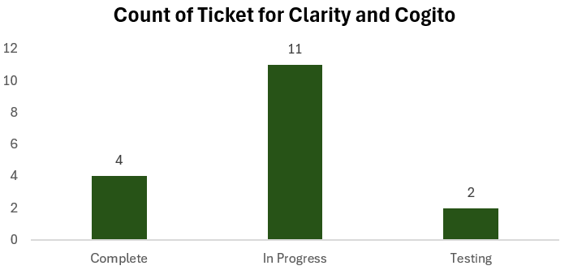
Reporting
Key Achievements
Module in numbers- or added explanation
Here are the key achievements for July 2025, highlighting our significant progress and milestones:
Service Now Tickets
Solution & Delivery
Ticket Triaging
Order Report
Highlights for monthyear
Primary Responsibility for Ticket Triaging:
Backlog clearance:
New Learning:
SQL Support for SER Team:

Slide 7
ECLink
Key Achievements
Ticket inflow for monthyear
Built 65+ Sites, 65+ EAF's, 65+ DEP's .
Service Now Tickets
Solution and Delivery
Site creations
Scope of work
Knowledge Transition
Highlights of monthyear
1. Site Creations in ECLink
2. DEP Builds
3. Migration Collaboration

